Slide 1
OTP Verification System using Python

Slide 2
DKTE’s TEXTILE AND ENGINEERING INSTITUTE, ICHALKARANJI.
Team members
Priyanka Shivanand Jotawar (20UET303)
Gayatri Arun Patil (20UET306)
Guided by
Prof. P C Dhanawade

Slide 3
INTRODUCTION
Used to verify a user by sending a unique password.
It removes the possibility of a user registering with a fake Mobile Number.
The plugin also checks if the Mobile Number of a user already exists.

Slide 4
DESCRIPTION
By running the code GUI window opens where user should enter the mobile no.
The OTP sent to the entered mobile no. then enter the OTP sent on users mobile and verify the output.
If the OTP is correct then Login of user is ‘Success’ else it says ‘Wrong OTP’. Then user may resend the OTP by selecting ‘Resend OTP’.

Slide 5
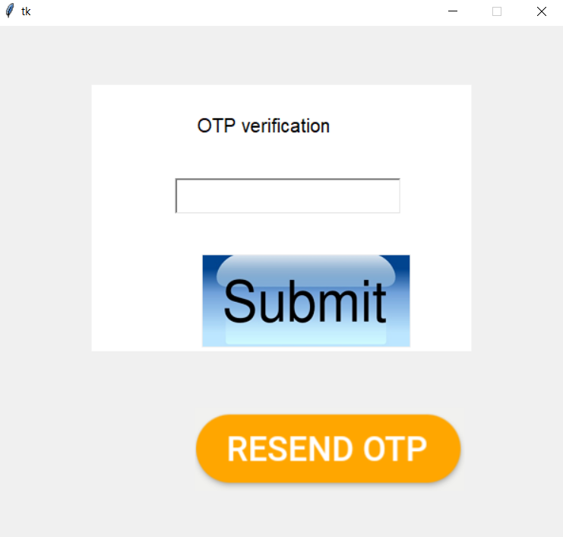
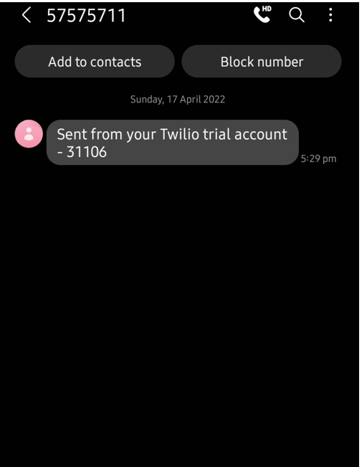
OUTPUT OF CODE

Slide 6
Benefits of OTP Verification System.
Cost Effective.
Cannot be reused.
Avoids Expensive Hardware token.
Time limited.

Slide 7
APPLICATIONS
Web applications.
Used over untrusted communication paths.
Can used with compromised user password.
Multiple generation mechanism.

Slide 8
CONCLUSION
A one-time password (OTP) is an automatically generated numeric or alphanumeric string of characters. It is used to authenticate and verify users before a transaction or a session in an app/website.

